Slide 1
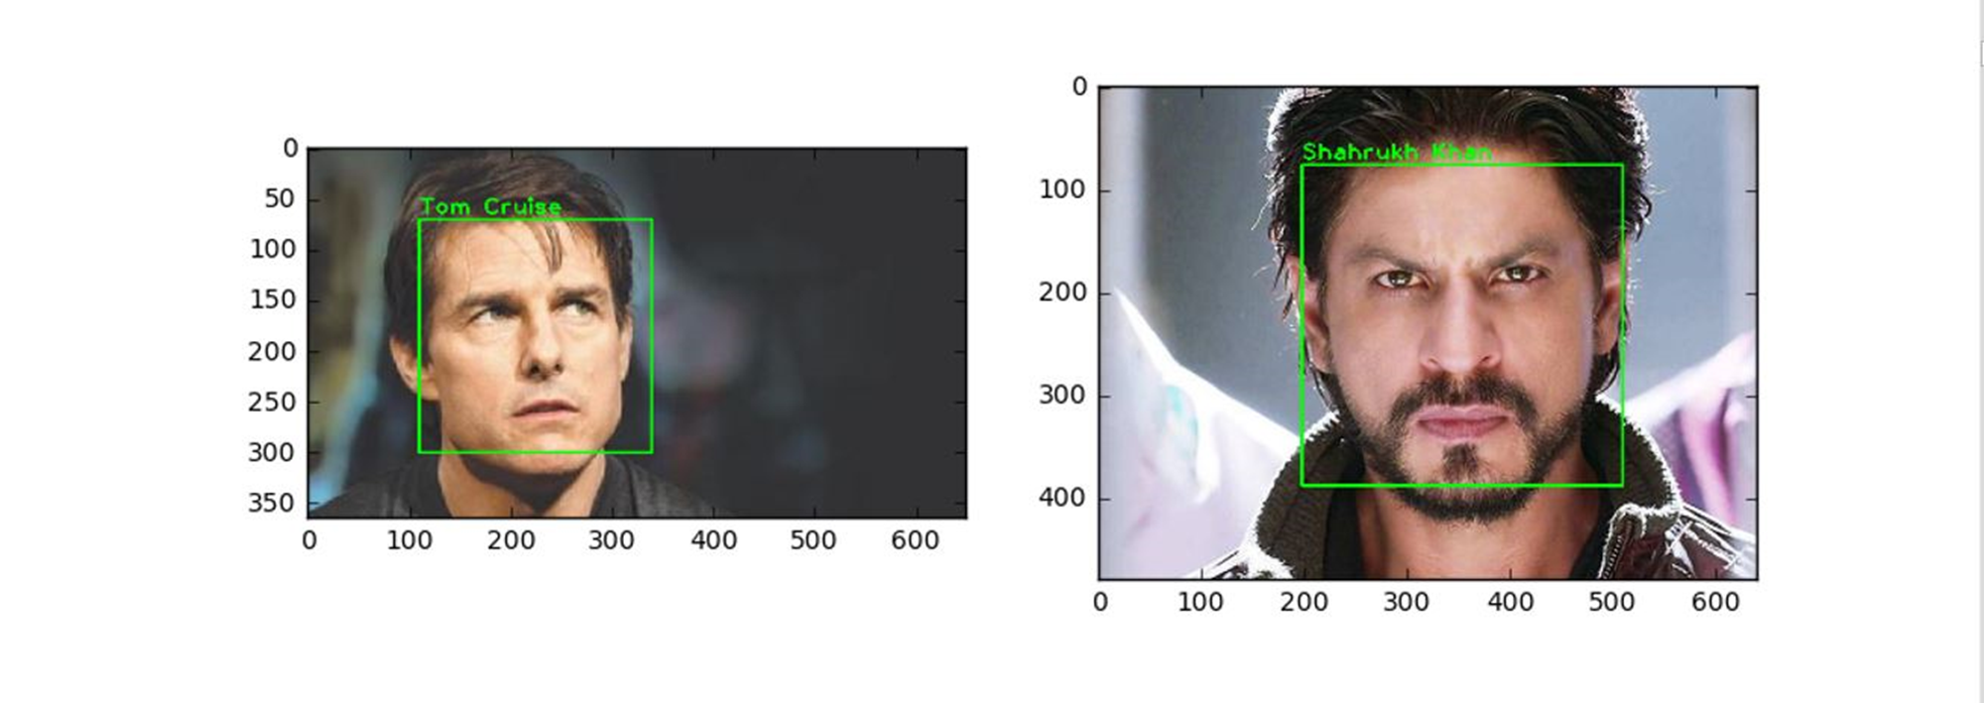
CAPSTONE PROJECT
ITA0516 – CV
Face recognition using python and open cv

Slide 2

Team Members
PRADEEP-192125044
MAHESH - 192125043
SRI ADITYA - 192125010
Guide – Dr.Christy

Slide 3

Project Plan
To Use
Python and OpenCV
to recognize faces along with their identity

Slide 4


Requirements
Google Collab
AMD Ryzen 7 4800H processor
16Gb RAM
1 TB SSD storage
NVIDIA RTX 3050 graphics card
Python IDLE 3.12
Dataset – Kaggle.com
Windows 11

Slide 5
ABSTRACT
This paper presents an intelligent face recognition system designed to identify individuals names based on facial features. The system utilizes advanced deep learning techniques to extract discriminative features from facial images and match them with corresponding names in a database. The effectiveness of the proposed system is demonstrated through comprehensive experiments and evaluations, showcasing its potential for real-world applications.

Slide 6
INTRODUCTION
Face recognition technology has seen remarkable advancements in recent years, with applications ranging from security systems to personalized user experiences.
However, conventional face recognition systems primarily focus on identifying individuals based on their facial characteristics without associating them with specific names.

Slide 7


MATERIALS AND METHODS
Data Collection
Preprocessing
Feature Extraction
Name Association
Training and Evaluation
DD

Slide 8

DISSCUSSION
The proposed system offers several advantages over traditional face recognition methods by providing a personalized identification solution.
By associating faces with names, the system enhances security, improves user experience, and enables personalized interactions in various domains.

Slide 9
RESULTS 1.Experimental results demonstrate the effectiveness of the proposed face recognition system in accurately identifying names associated with detected faces. 2.The system achieves high accuracy rates across diverse datasets and outperforms existing methods in name identification tasks.

Slide 10

CONCLUSION
1.In conclusion, the presented intelligent face recognition system offers a promising solution for name identification in diverse applications.
2.By leveraging deep learning techniques and advanced algorithms, the system demonstrates robust performance and scalability.

Slide 11
SCOPE
The proposed face recognition system has broad potential applications in security, marketing, customer service, and social interactions.
Further research could explore extensions to handle real-time processing, large-scale databases, and multi-modal biometric recognition
DD

Slide 12
References
[1] FaceNet: A Unified Embedding for Face Recognition and Clustering - Florian Schroff, Dmitry Kalenichenko, James Philbin
[2] DeepFace: Closing the Gap to Human-Level Performance in Face Verification - Yaniv Taigman, Ming Yang, Marc'Aurelio, Lior WolfRanzato

Slide 13


